Slide 1
Climate change from the point of view of chaos theory
Klímaváltozás káoszos szemmel
Tamás Tél Institute for Theoretical Physics,
Eötvös University, Budapest,
MTA-ELTE Theoretical Physics Research Group

Slide 2
A common wisdom:
„Wheather is what you get,
climate is what you expect.”
What is the basis of the expectation?
Can it be the past, in a changing climate?
What is the probability distribution which enable you to predict the climate in 2100, if climate is changing?

Slide 3
Motivation from the point of view of applied math
Little is known about general nonautonomous systems,
although they are very common
The concept of snapshot attractors enables one the extend what we know about periodically driven cases to any form of the driving.
There is a probability distribution on snapshot attractors and this could be the one relevant to climate change
Illustrate the concept via simple chaotic systems

Slide 4

Motivation from the point of view of climate research
IPCC – Intergovernmental Panel
on Climate Change Report,
The Physical Science Basis, 2013
Key concepts:
Internal variablity
External variability
In our language:
Consequence of the internal dynamics, of chaos
External force, driving of astronomical or
anthropogenic origin
Climate: „the average weather”. „The classical period of averaging
is 30 years.”
Ergodic hypothesis might be in the background.
Is this correct in climate change?

Slide 5

Edward Lorenz
(1918-2008)
The discoverer of dissipative chaos,
of sensitive dependence on initial conditions,
of unpredictability in dynamical systems

Slide 6
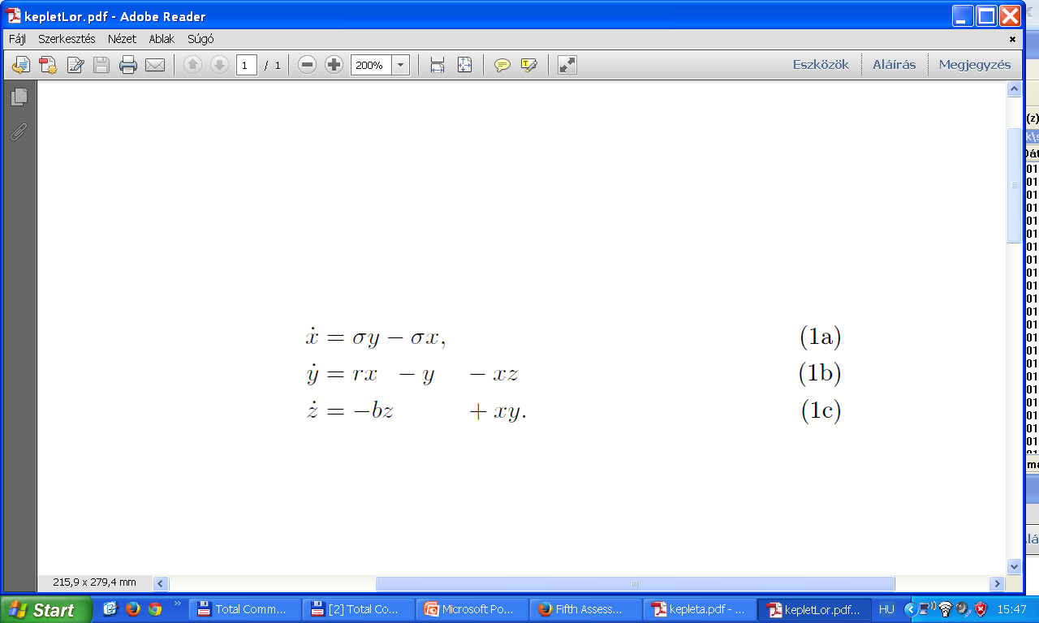
The Lorenz model (1963)
J. Atmos. Sci. 20, 130, a celebrated, paradigmatic example of chaos
A three-variable system of ordinary differential equations:
Standard parameters r=28, σ=10, b=8/3
From the internet:
In the early 1960's using a simple system of equations to model convection in the atmosphere, Edward Lorenz, an MIT meteorologist, ran headlong into "sensitivity to initial conditions". …
In Lorenz's meteorological computer modeling, he discovered the underlying
mechanism of deterministic chaos

Slide 7
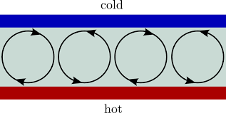
Thermal convection
Take a shallow layer of fluid and heat it from below.
For a small temperature difference, ∆T the fluid remains at rest.
At a critical difference ∆T_{c}
and sligthly above:
convective rolls
√2 times the height
x ~ fluid velocity in rolls
y,z ~ amplitude of two modes of heat
convection (~sin and ~cos)
σ: material property, b: geometric factor due to √2,
r= ∆T/∆T_{c}
In a 2mm layer of oil: ∆T_{c} = 50 ºC

Slide 8
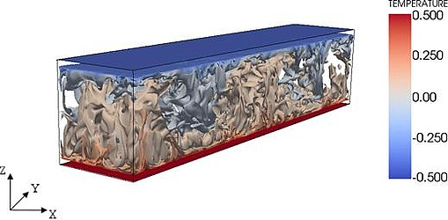
Where is chaos?
At r=28, i.e. at ∆T= 28 ∆T_{c}
For the oil layer: 1400 ºC!
So much beyond the onset
- material properties are different,
- geometry is different:
- the Lorenz equations do not describe any hydrodynamics.
From the internet:
In the early 1960's using a simple system of equations to model convection in the atmosphere, Edward Lorenz, an MIT meteorologist …
In the chaotic regime, the Lorenz model has no physical relevance!

Slide 9
Properties of chaos
based on the Lorenz attractor
- Irregular (nonperiodic),
long lasting time-dependence
t
- Sensitive dependence on the
initial condition, unpredictability,
individual trajectories are not
meaningful
t
t

Slide 10
- Structured, fractal pattern
in phase space, the chaotic attractor
- Probability distribution
on the attractor
(here the r=27 slice),
a meaningful characterization
of chaos

Slide 11
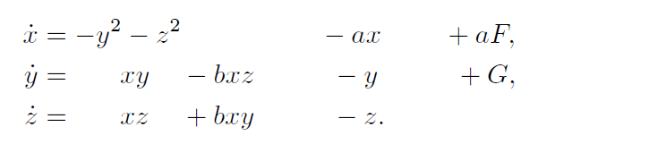
Lorenz’s atmospheric model (1983)
Tellus 36A, 98
A three-variable system of ordinary differential equations:
E=x²+y²+z² damping driving
conserved
Standard parameters a=1/4, b=4, G=1, 5<F<10.
Interpretation
x: average speed of the westwind over the Northern hemisphere
y,z: two modes of heat transfer, of cyclinic activity
time unit: 5 days (lifetime of cyclones)
G: geographic asymmetry
F~ temperature difference between North Pole and Equator

Slide 12
Lorenz’s atmospheric model (1983)
A masterpiece: cannot be derived from first principles, captures, neverthless,
basic features of the climate
Constant driving:
a) F=6: perpetual summer
Two coexisting,
regular attractors
Inactive summer
Active summer

Slide 13
b) F=8: perpetual winter
A single
chaotic attractor
1 year=73 times units=73 times 5 days
Winters are known to be more variable than summers.

Slide 14
The chaotic attractor of winter
In the 3-variable
phase space
In the z=0 slice
Probability distribution on the z=0 slice

Slide 15
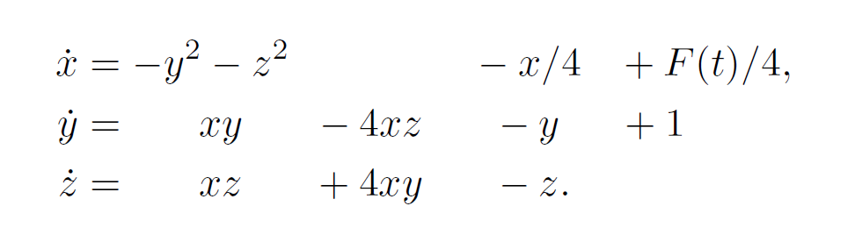
Seasonal driving
If the Pole-Equator temperature difference is time-dependent
Annual periodicity introduced by Lorenz (1990) Tellus, 42A, 378
F(t)=F₀+A sin(ωt) =7 + 2 sin(2 π/T t)
T=1 year = 73 times 5 days
The regular summers and chaotic winters are coupled,
no regularity remains.
Notes:
Legegyszerubb zavaras: additiv, imsert DE altal generalt

Slide 16
Seasonal driving
The alteration of inactive and active summers is consistent with
meteorological experience.

Slide 17
Comments:
This is a yet unchanging climate (the annual average temperature difference is constant)
The theory of dynamical systems driven by constant or periodic forcing is well known – is based on periodic orbits.
In such cases the the attractors are ergodic: a long single trajectory traces out the same object as many relatively short trajectories: temporal and ensemble averages are identical. Eckmann , Ruelle, Rev. Mod. Phys. 57, 617 (1985): Ergodic theory of chaos and strange attractors
When turning to climate change, the the time scale of interest is
hundreds of year – no ice ages no paleoclimate.
The aim is merely the concept: we do not intend to make any prediction
The real atmosphere and ocean dynamics are more complicated than chaotic: they are turbulent since complexity is spatio-temporal

Slide 18
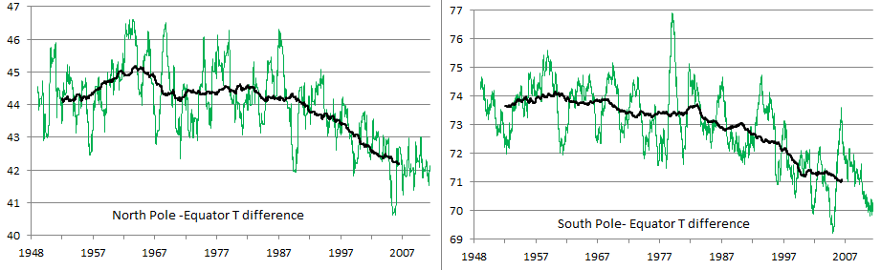
A basic fact of climate change
The temperature contrast decreases

Slide 19
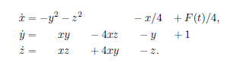
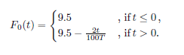
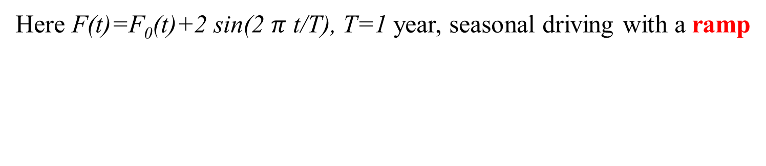
The generalization of Lorenz’s model to climate change
Here F(t)=F₀(t)+2 sin(2 $π$ t/T), T=1 year, seasonal driving with a ramp
In year 0 climate change sets in,
and the average temperature contrast decreases from
F=9.5 to F=6.5 over 150 years
Notes:
Legegyszerubb zavaras: additiv, imsert DE altal generalt

Slide 20


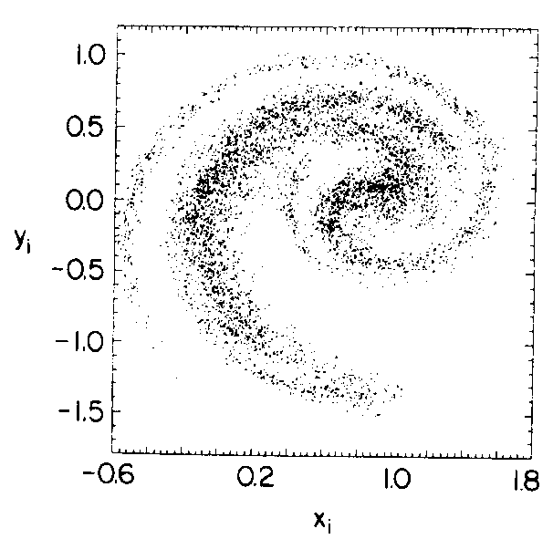
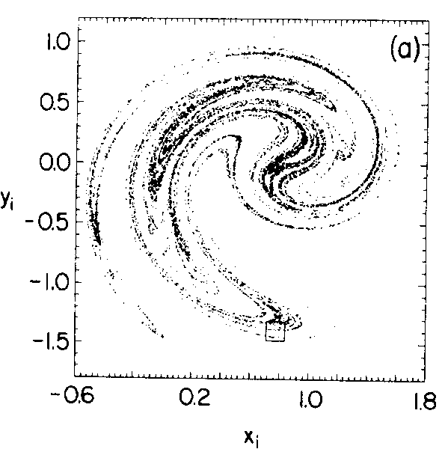
Snapshot attractors
Consider a nonautonomous system, but besides a single trajectory, use an ensemble
After a while a fractal pattern might
emerge in the ensemble
Romeiras, Grebogi, Ott, Phys. RevA, 784 (1990).
Snapshot attractor: clear fractality
A single trajectory noisy attractor
Ergodicity does not hold.

Slide 21

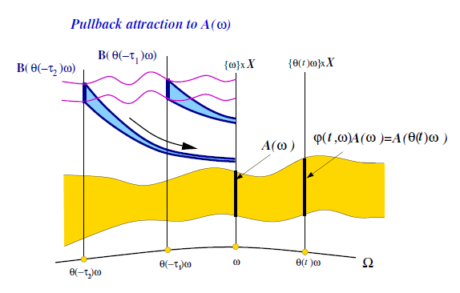
In the context of climate
Pullback=snapshot attractor in ODE-s: the union
of points at time t which are approached by trajectories
started in the distant past
Ghil, Chekroun, Simonnet, Physica D 237, 2111 (2008)
All snapshot attractors depend on time

Slide 22
The numerical procedure in our model
Initial conditions: distributed randomly in a large box in (x,y,z)
much before t=-150 years, well in the stationary climate,N ~ 10⁵
Monitor all N trajectories up to time t, the shape traced out be the ensemble
is the snapshot attractor
In order to concentrate on the global changes (and eliminate seasonal periodicity)
we choose a single day, the midwinter days of each year
(a kind of stroboscopic map)
The density of point also defines a probaility distribution on the snapshot
attractor

Slide 23
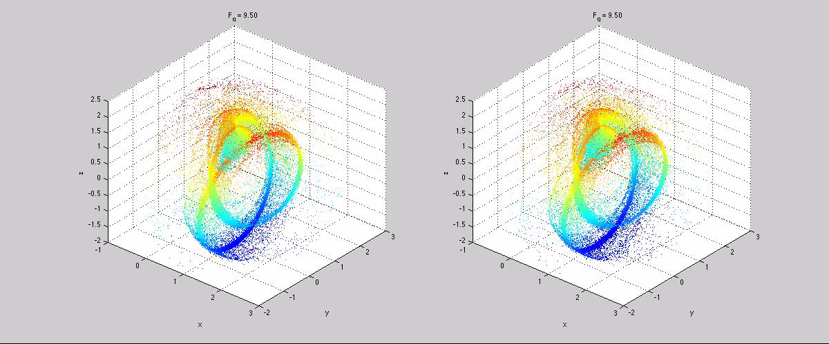
A movie of the three-dimensional attractors

Slide 24
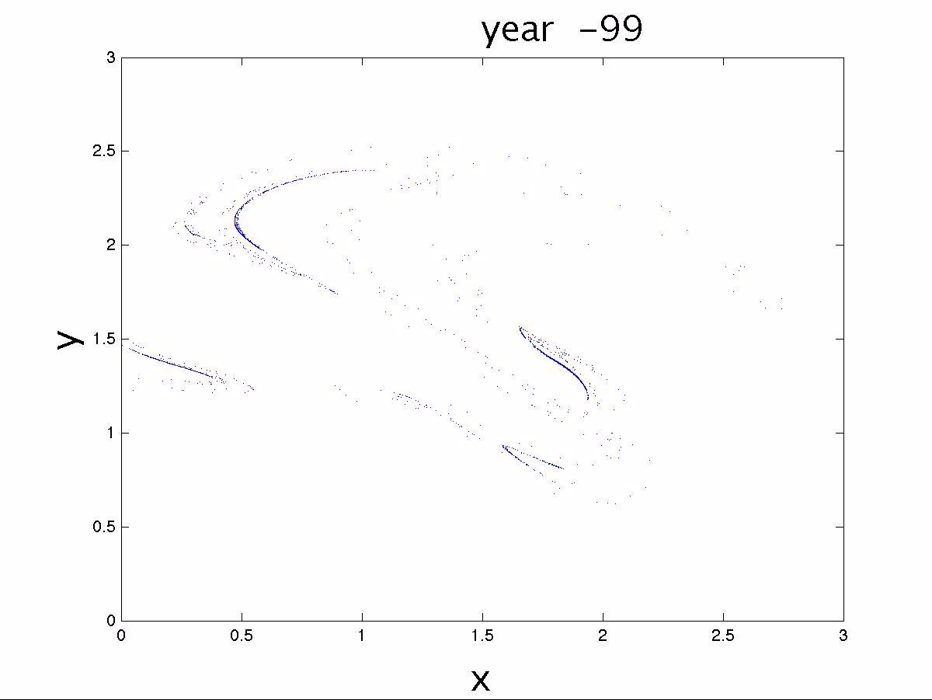
A movie of the attractor on the z=0 slice

Slide 25
Midwinter snapshot attractors
In years 25, 75, 125 and 150 after the onset of climate change, initialization 150 years before the onset, N=10⁵

Slide 26
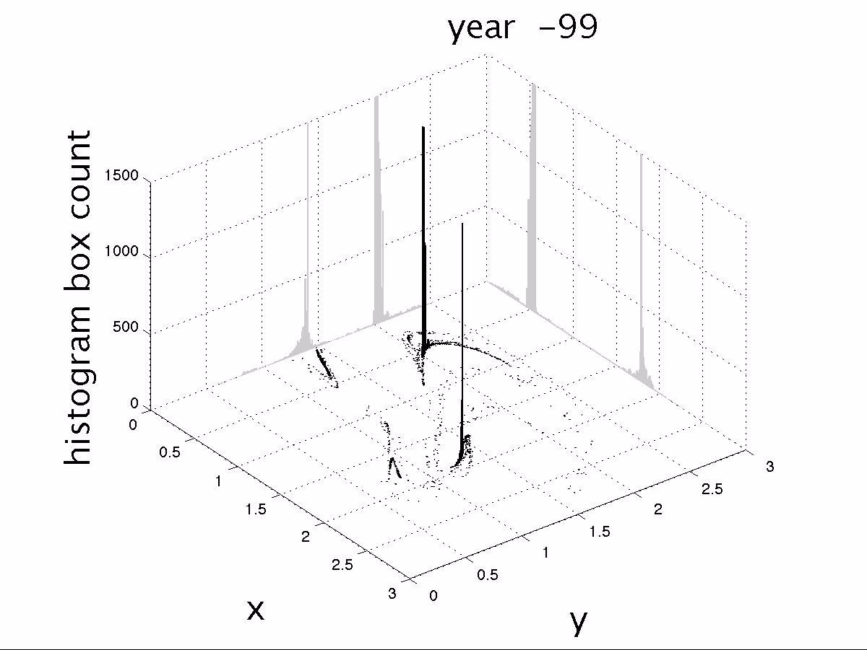
A movie of the probability distribution
on the z=0 slice (movies by T Bódai)

Slide 27
A few examples of snapshot attractor natural distributions
Midwinter measures 25, 50, 88 and 89 years after climate change.
Note the drastic change within a single year.

Slide 28
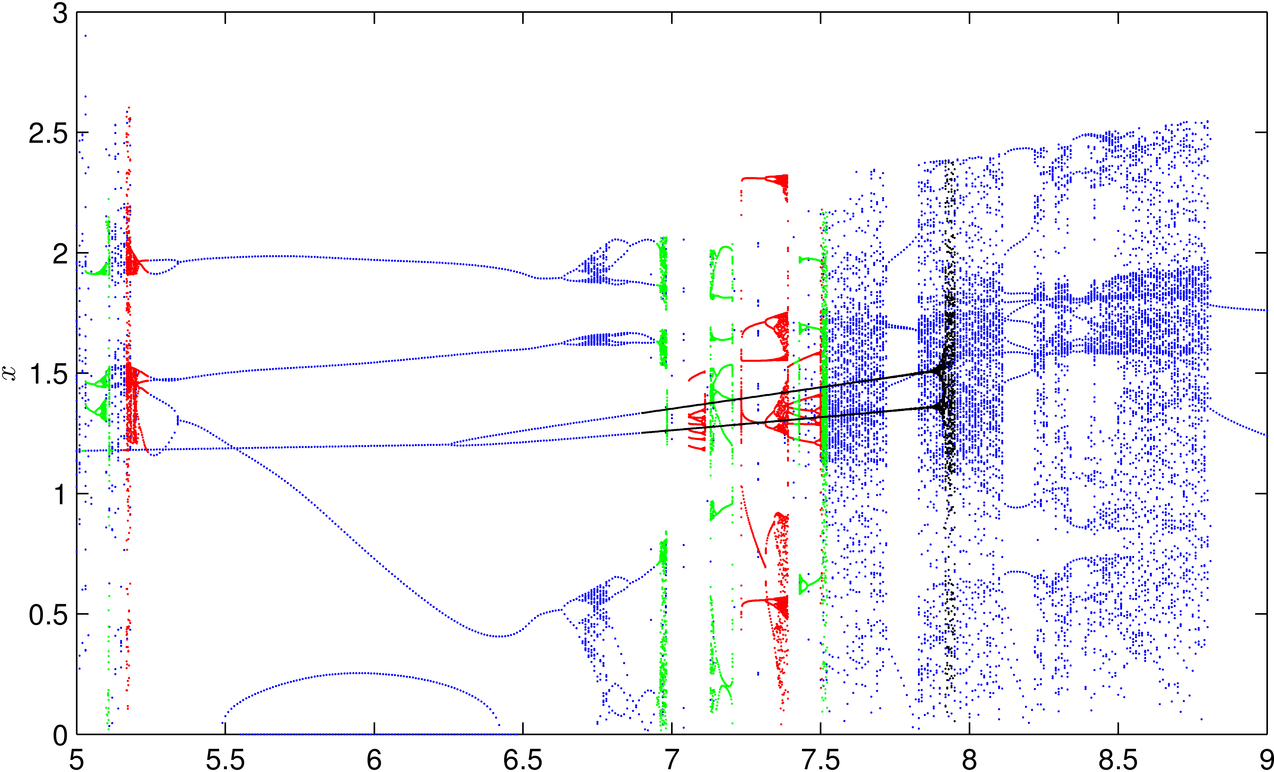

Bifurcation diagram with constant driving, F
summer
winter
Temporal driving washes the periodic windows into permanent chaos!

Slide 29
Equivalence of the distributions from different ensembles
We initiate ensembles in year 10 and year 30 after the onset
of climate change. Natural distributions in year t=50
initiated in year 10 in year 30
The snapshot attractor and its distribution are independet of the initial ensemble for t>tc. They are objective quantities, the analogs of steady state distributions (without steadyness).

Slide 30
Comparison of averages obtained with different ensembles
Black: ensemble start
in year -150
Red: ensemble start
in year 10
Blues: ensemble start
in year 30
0 10 20 30 40 50 (year)
Convegence time: t_{c} is approximately 5 years

Slide 31
Consequences
The probability distribution on the snapshot attractor offers a unique characterization of internal variability (povided the ensemble is intiated
a time t_{c} earlier).
Time t_{c} is short.
The probability distribution changes with time
Averages should be taken with respect to this probability distribution.
Averages (on a given day of the year) become time-dependet in climate change.

Slide 32
„Expectations” should be taken with the natural
distribution of the snapshot attractor at any time t
Midwinter x (speed of westerlies) values
Pink: individual trajectory
Black: ensemble average
N=10⁶
-50 0 50 100 150 (year)
t_{c}=5 years convergence time
stationary climate changing climate
ergodic nonergodic
Individual trajectories are
not representative

Slide 33
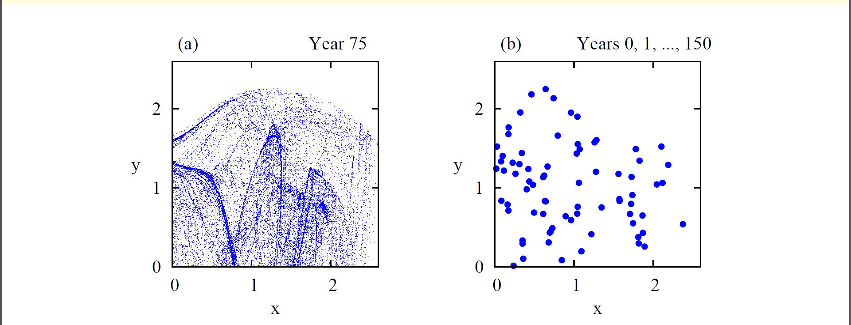
Difference between snapshot attractor and
a single trajectory plot
Results projected on the x,y plane for 150 years of climate change
snapshot distribution of the midwinter day of an intermediate year (year 75)
sequence of the 150 midwinter
days over the investigated period
The patterns are completely different, and good statistics
can only be obtained in the snapshot view..

Slide 34
Comparison with temporal averages
Temporal averge is taken over the last 30 years as usual today.
Black:
snapshot average
Colored: 30 year
temporal average
along 3 different
single realizations
-50 0 50 100 150 (year)
stationary climate changing climate
ergodic nonergodic
30-year temporal averages differ from the ensemble average even in the
ergodic regime since ergodic hypothesis holds in the long time limit only.
The ensemble averages strongly differ from the 30-year temporal
averages

Slide 35
What is Climate Change?
Climate change can be seen as the evolution
of snapshot attractor and its natural measure
Trends in 30-year averages do not necessarily indicate climate change since any individual trajectories are not representative
The snaphsot/ensemble view can be a new tool in
numerical climate prediction
Bódai, Tél, Chaos 22, 023110 (2012)
Bódai, Károlyi, Tél, Phys. RevE 87, 022822 (2013).
Drótos, Bódai, Tél, J. Climate 28, 3275 (2015)

Slide 36
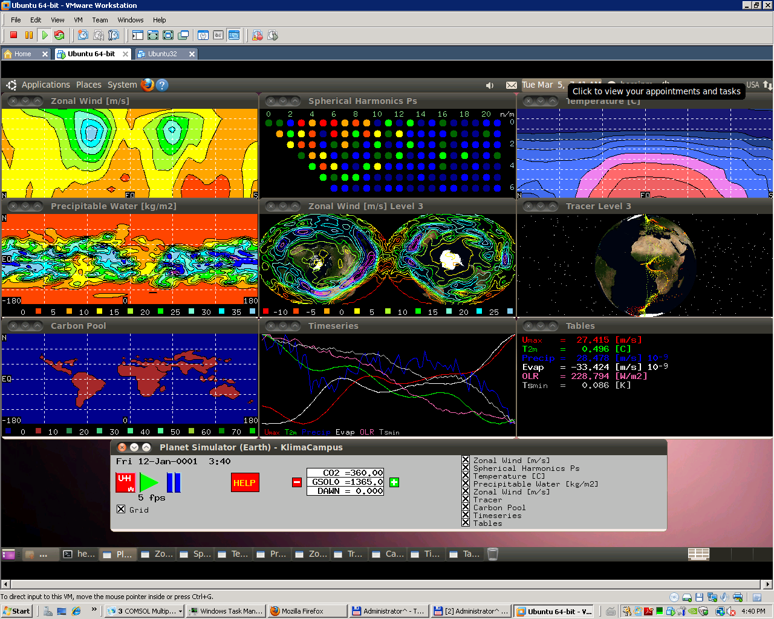
Results in a high degree of freedom climate model
Planet Simulator: developed by the University of Hamburg, freely available
Number of the degrees of freedom: 10⁵
Several interesting fields (temperature, windspeed, pressure, etc) available
The aim of the use of this program is conceptual, we do not intend to predict
anything.

Slide 37
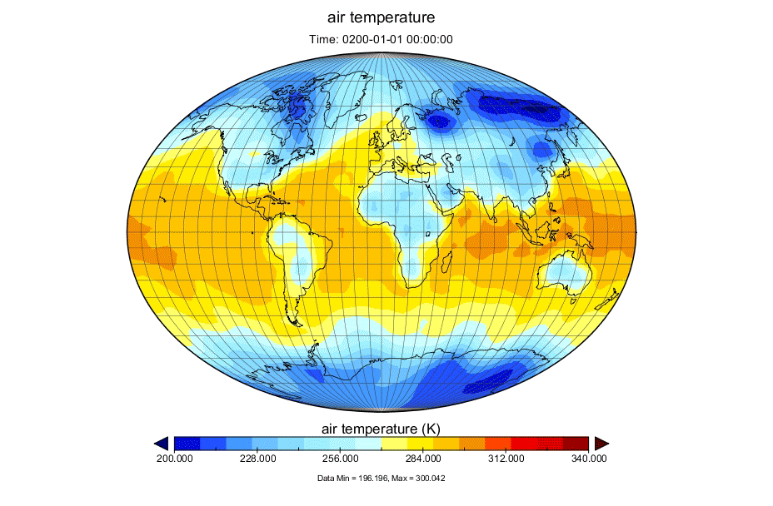
A sample: air temperature,
all fields are turbulent
Notes:
MLO kiugras !!!

Slide 38
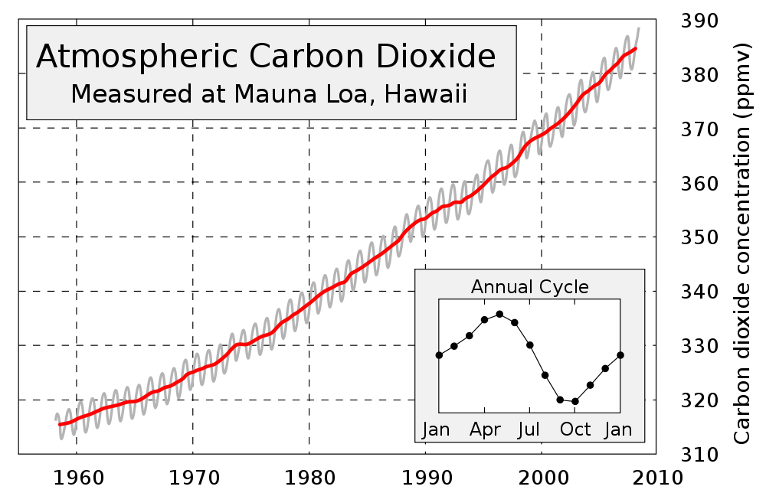
A basic fact of climate change
The Carbon Dioxide content increases . This is the origin of the decrease of the
temperature contrast discussed earlier.

Slide 39
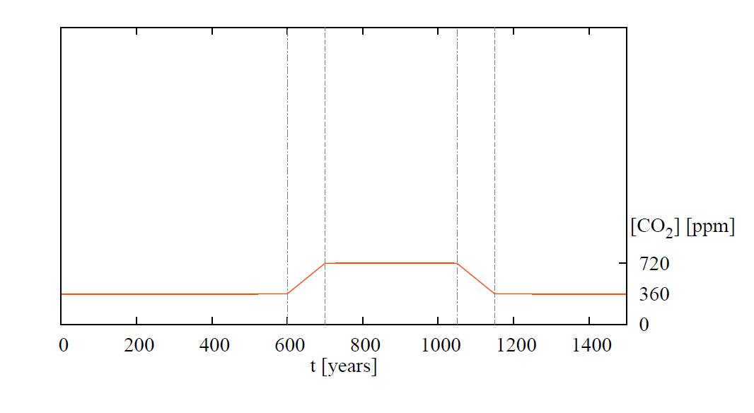
A direct CO₂ forcing is possible in Planet Simulator
The scenario taken by us Herein, Márfy, Drótos, Tél, J. Climate, in press:
We followed an ensemble of N=40 randomly chosen initial states and
performed different ensemble averages. Regional averages also possible.

Slide 40
Response in the surface temperature over Hungary
Colored lines: ensemble members, dark line: ensemble average
Attracting property demonstrated (red and violet curves)
Exponential convergence time, t_{c} =150 years
Note the deviation from the shape of the CO₂ scenario

Slide 41
A different representation: T vs CO₂ concentration
A hysteresis appears, response is nonlinear
When reaching the same CO₂ concentration on the ramp downwards,
the temperature is higher than on the upward ramp - memory.
Individual trajectories are non-representative again.

Slide 42
Hyteresis on the scale of Europe
Fluctuations are smaller on larger scales

Slide 43
Conclusions
Snapshot attractors and their natural distributions
provide a proper tool to characterize climate
variability conceptually, and in numerical simultions
Such a probability distribution characterizes the climate of a given
time instant
They are independent of the way of their numerical
simulations (at t> t_{c}). The distribution is unique.
The averages obtained this way strongly differ from the 30-year temporal averages widely used.
We recommend the use of the ensemble averages also in accurate numerical predictions (and the suppression of 30-year averages
where possible).
Many thanks for T. Bódai, G. Drótos, M. Herein and G. Károlyi for the
joint works.

